Slide 1
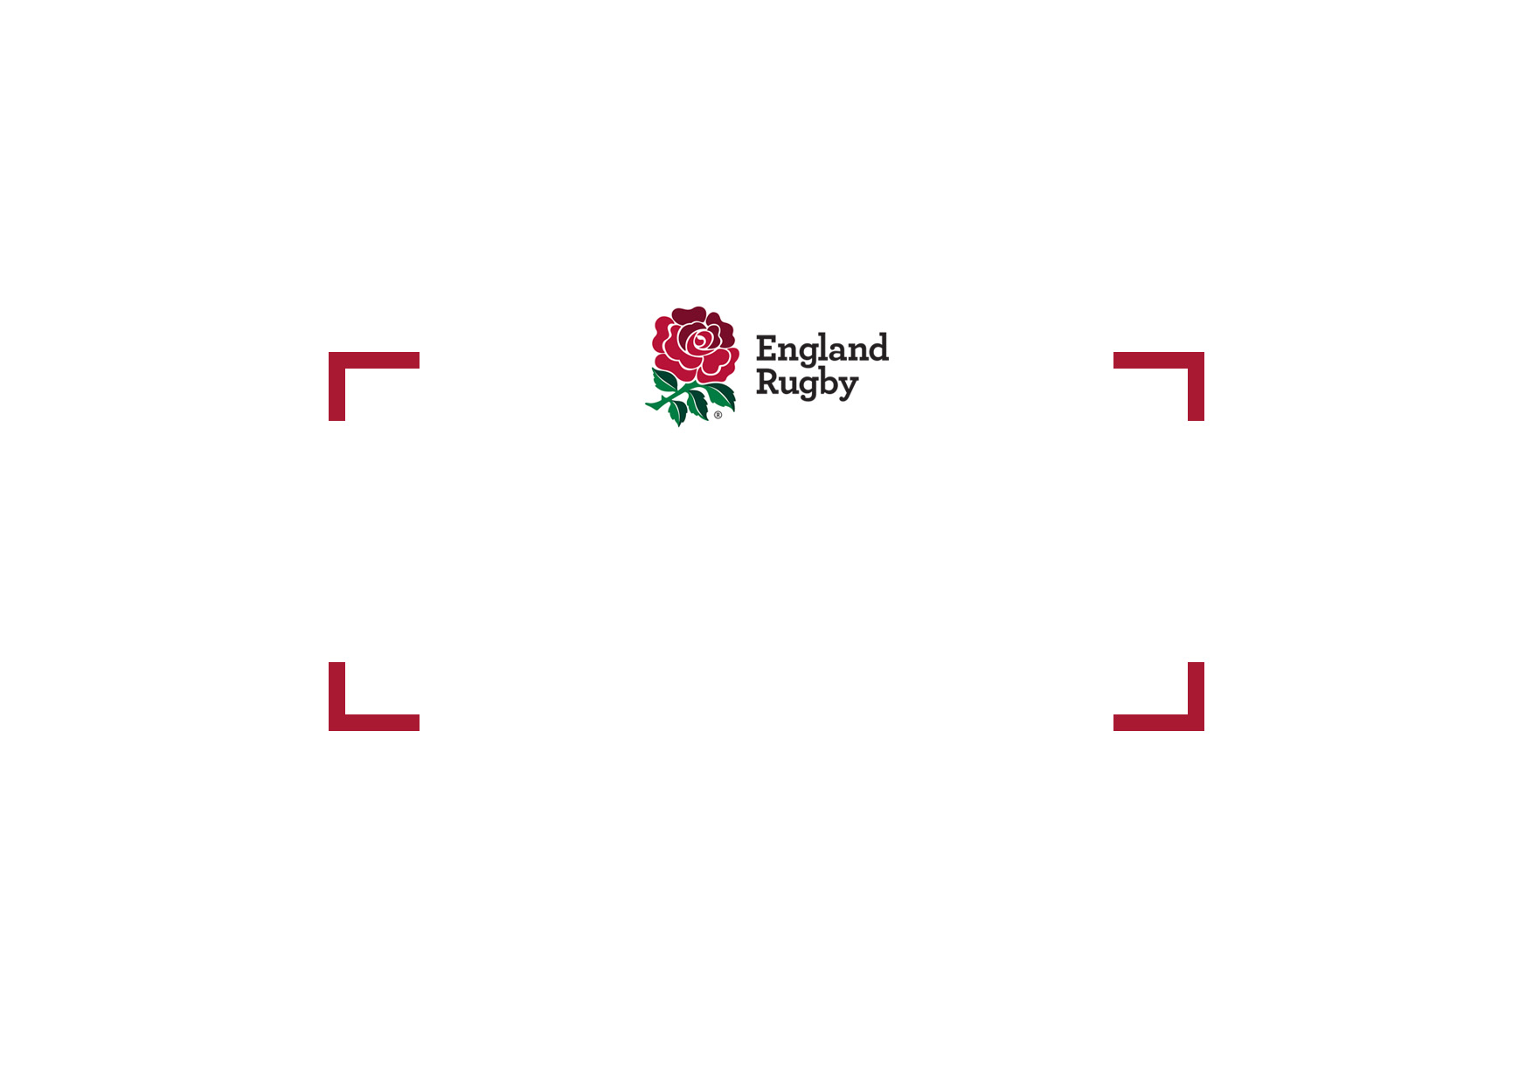
National League Update

Slide 2
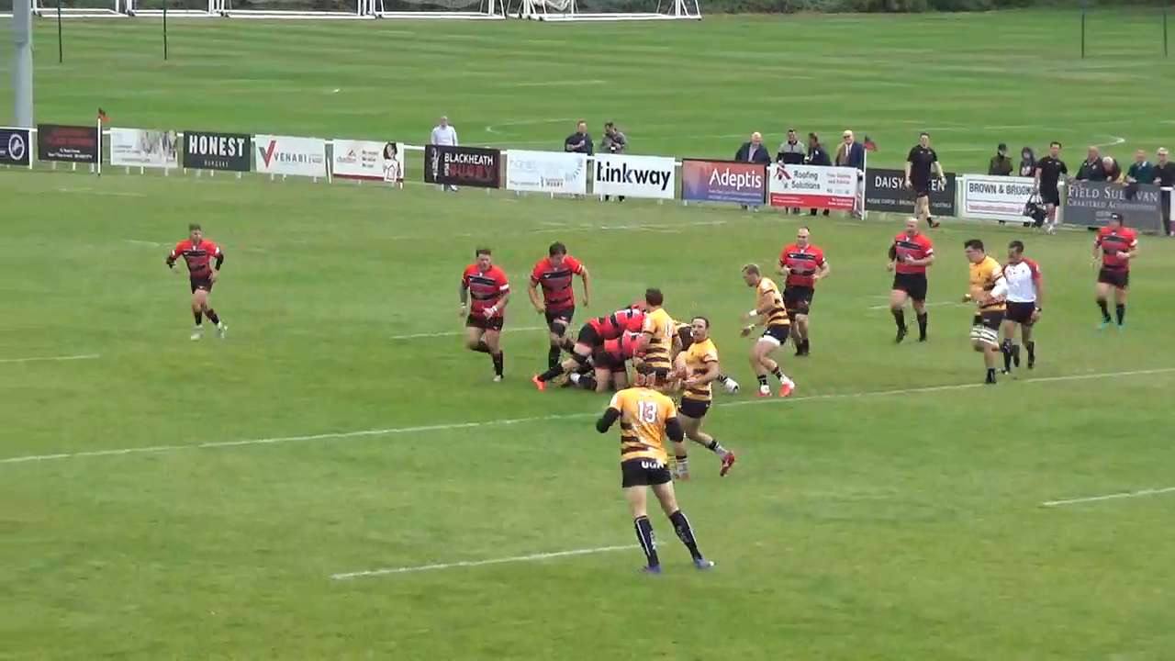
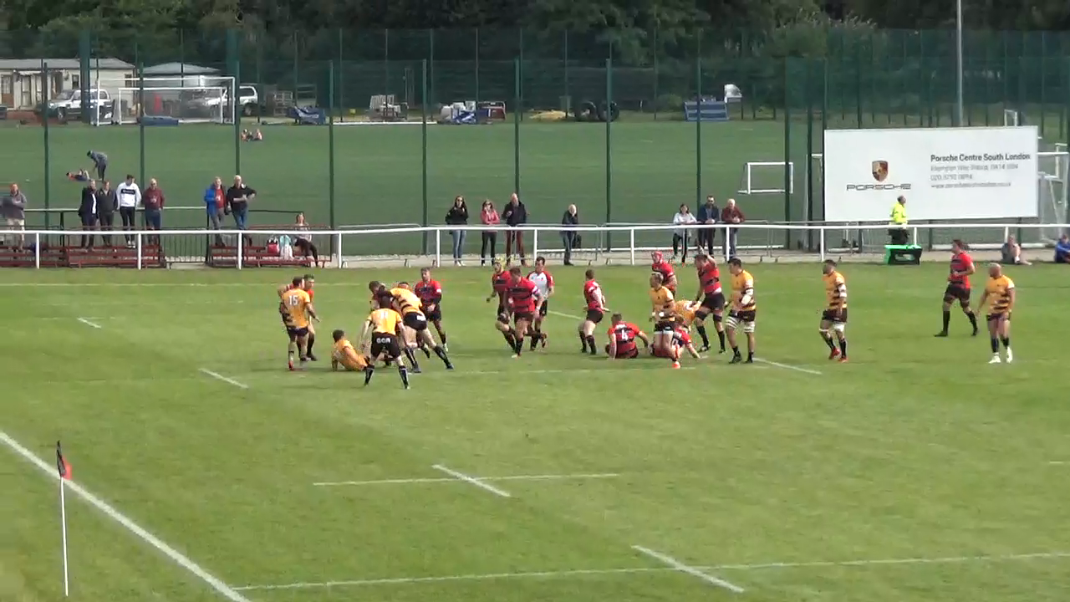
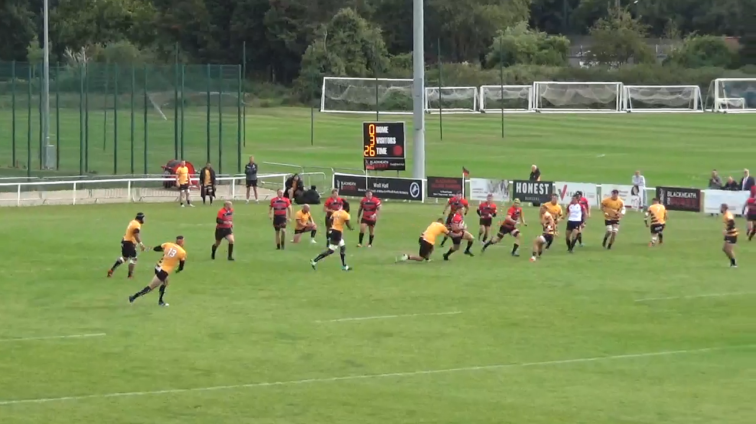
National League Update
Game Values: Players Appealing
Clip 1: Player warned for waving Arms, the captain spoken too when time off in first 2 minutes of game
Clip 2: Penalty is awarded for backchat, players and captain already been warned – 3rd occasion = PK
Clip 3: No 9 warned after PK been awarded, could lead to a reversal of decision.

